Slide 1
Ally Skills 101: Why Allies?
Diversity and Inclusion for Academia and Science in 2019
We acknowledge the land we are meeting on is the territory of many nations, including the Seminole and Timicua peoples.
http://frameshiftconsulting.com/
CC BY-SA Frame Shift Consulting, Sara Smollett,
Ellen Bledsoe, Kelsey Lewis
@bleds22e
@feministbiology
Notes:
EB
Hi and welcome! We’re here today to talk about a different approach to diversity and inclusion in science. Our goal is to make the 2019-2020 academic year the year of focusing on allies.
License is CC BY-SA 4.0 http://creativecommons.org/licenses/by-sa/4.0/

Slide 2
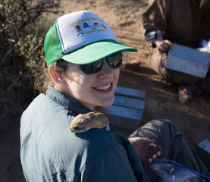
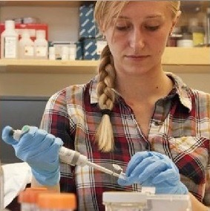
Who are we?
Ellen Bledsoe
Ph.D. Candidate
School of Natural Resources & Env.
she/her/hers
Kelsey Lewis
Ph.D. Candidate
Biology
she/her/hers
Notes:
EB
Graduate students here at UF
Part of the newly-formed Ally Skills Network

Slide 3
This is not the Ally Skills Workshop
The Ally Skills Workshop is 3 hours long, mostly group discussion
There is an Ally Skills Workshop for students and postdocs:
October 14, 1-4 PM, in the UF Informatics Institute
also available as an online workshop
More info here:
https://ufallyskillsnetwork.weebly.com
https://frameshiftconsulting.com/ally-skills-workshop
Notes:
EB

Slide 4
Questions?
[link to google form for anonymized questions]
Notes:
EB

Slide 5
Why Allies?
Estrada et al., 2016
Notes:
KL
https://www.ncbi.nlm.nih.gov/pmc/articles/PMC5008901/
Current percentages of underrepresented minority, white and Asian/Pacific Islander populations with STEM degrees. URM includes African American, Hispanic or Latino/Latina, American Indian, and Alaskan Native. In this analysis, “STEM degrees” includes degrees categorized by the NSF as “Science & Engineering” (but excludes degrees in psychology and social sciences) in data tables prepared by the National Center for Science and Engineering Statistics based on data from the U.S. Department of Education’s IPEDS 2010 Completions Survey. Sources: population: U.S. Census Bureau, 2010 Census
Also see:
NSF report on Women, Minorities, and Persons with Disabilities in Science and Engineering: https://ncses.nsf.gov/pubs/nsf19304/digest

Slide 6
What is an ally? Some terminology first:
Privilege: an unearned advantage given by society to some people
Oppression: a systemic, pervasive inequality that is present throughout society, that benefits people with more privilege and harms those with fewer privileges
Notes:
KL

Slide 7
What is an ally? Some terminology first:
Marginalized person: a member of a group that is the primary target of a system of oppression
Ally: a member of a social group that enjoys some privilege that works to end oppression and understands their own privilege
Actions
Notes:
KL
“The truth is, however, that the oppressed are not “marginals,” are not living “outside of society.” They have always been inside the structure which has made them “beings for others.”
The solution is not to “integrate” them into the structure of oppression but transform that structure so they can become ”beings for themselves”
Paulo Freire, Ch 2 Pedagogy of the Oppressed

Slide 8
Example
Privilege: The ability to walk into a convenience store and have the owner assume you are there to buy things and not steal them
Oppression: The self-reinforcing system of stories, TV, news coverage, police, and legal system stereotyping Black people as criminals, that benefits non-Black people and harms Black people
Notes:
KL

Slide 9
Example
Marginalized person: Any Black person who wants to enter a convenience store
Ally: A non-Black person who donates to legal system reform organizations, actively objects to racist stories, calls their representatives to support police reform, and reads articles or books about this privilege
Actions
Notes:
KL

Slide 10
Sources of power and/or privilege
Part of the dominant ethnic and/or racial group Male Masculine Cisgender (your gender is the same as that assigned to you at birth) Straight Not disabled A legal resident or citizen Speak the dominant language, especially with high-status accent Neither "too young" nor "too old" Certain height/size/shape Not a mother Not a caregiver From an upper or middle class family High caste | Educated Technically experienced Wealthy (compared to peers) Management position Professor, teacher, supervisor, teaching assistant, etc. Parent or family leader Any position in a hierarchy that is not the bottom of the hierarchy Widely recognized as an expert Large audience (social media following, fans, etc.) Access to media (reporters, TV shows, editors, etc.) Respected by powerful people
Notes:
EB
A privilege is an unearned advantage granted by society to some people but not all. Power is the ability to control circumstances or resources.
**Everyone has the ability to be an ally in some situation**

Slide 11
What do diversity and inclusion mean?
Diversity: The state of having people in a group who differ along race, gender, sexuality, age, disability, religion, class, caregiver status, etc.
Inclusion: Everyone in a diverse group is valued, included, and respected, without discrimination or bias
CC BY Steve Garry
https://flic.kr/p/2TTztX
Notes:
EB

Slide 12
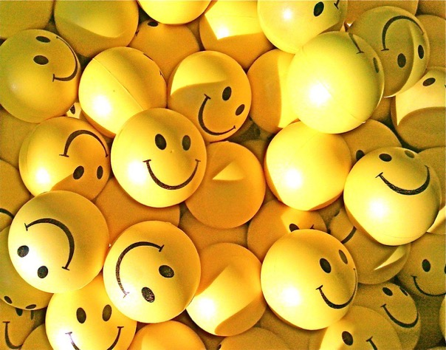
Common misunderstandings
An individual can’t be “diverse;” diversity exists only in the context of a group
Many efforts focus on increasing diversity without also increasing inclusion
CC BY Senorhorst Jahnsen https://flic.kr/p/5QSiBv
Notes:
EB

Slide 13
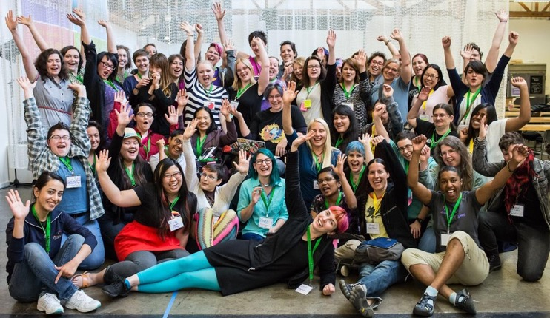
Examples of diversity and inclusion efforts
Volunteer-run affinity groups
Travel scholarships
Code boot camps
Advice books for the marginalized
Volunteer-run mentoring programs
Recruiting outreach
Conferences for marginalized groups
AdaCamp Portland
CC BY-SA Jenna Saint Martin Photo
Notes:
EB
So, what do diversity and inclusion initiatives usually look like? (Read slide) and this is a photo of a conference for women in open technology and culture called AdaCamp.

Slide 14
What’s wrong with diversity and inclusion today?
Most work focuses on helping marginalized people fit in existing systems of oppression
Less work focuses on training allies to dismantle systems of oppression
Notes:
KL

Slide 15
Reasons why efforts focus on marginalized people
They directly benefit from change and are more self-motivated
They are often more aware of oppression
They are often lower status and easier to tell what to do
They are seen as the cause of the problem
Avoids confronting feelings of guilt in privileged people
Notes:
KL
So, there are reasons why people focus on changing the behavior of marginalized people. (Read slide) Not always, but often. The classic example here is people complaining about women in the workplace causing sexual harassment or assault - it’s usually men who are doing the harassment, but no one suggests removing all men from the workplace to solve the problem. (Read slide)

Slide 16
Why not focus on marginalized people?
CC BY Nicolas Raymond
https://flic.kr/p/eeZ2WB
Notes:
KL
Those are some of the reasons to focus on marginalized people. Now what are the reasons we shouldn’t focus on marginalized people?

Slide 17
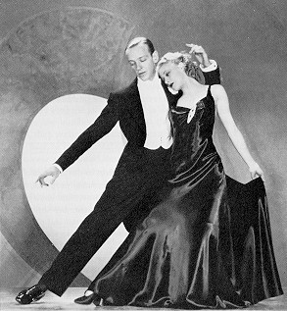
Marginalized people are overworked
© RKO Pictures
Notes:
KL
First, marginalized people are overworked. In addition to all the normal work, they have a bunch of extra work to do to cope with being part of a marginalized group. The old saying, “Ginger Rogers did everything Fred Astaire did, except backwards and in high heels” is so popular because it rings so true.

Slide 18
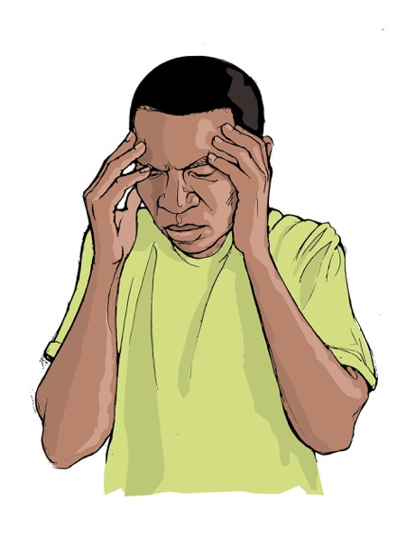
Marginalized people are under more stress
Discrimination
Harassment
Abuse and assault
PTSD
Notes:
KL
Marginalized people are under more stress from a variety of causes.
Stereotype threat is the fear that you will confirm the negative stereotypes about a group you are part of, and it creates an enormous mental overhead that reduces your performance.
Discrimination, whether overt or covert, both directly harms your work and creates mental stress that leads to more harm. Harassment comes in many forms and is intended to cause you to leave your position. Outright abuse and assault are far more common than many people think, due to the likelihood of retaliation and job loss if the marginalized person reports.
And PTSD is the long-term cost of living through these conditions.
https://commons.wikimedia.org/wiki/File%3ASymptoms-headache.jpg

Slide 19
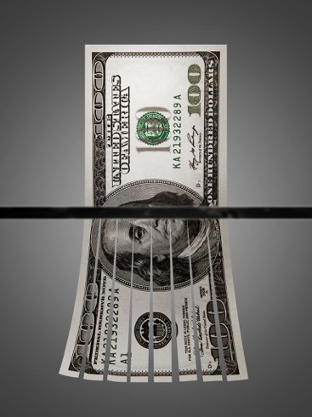
Marginalized people have less money
87%: Asian women vs. white men
79%: Lesbian couples vs. men married to women
78%: white women vs. white men
73%: Black men vs. white men
73%: mothers vs. fathers
65%: Black women vs. white men
63%: people with disabilities vs. those without
58%: Latinas vs. white men
More likely to have unpaid caregiver responsibilities
CC BY Tax Credits
https://flic.kr/p/bZwHv5
http://www.pewresearch.org/fact-tank/2016/07/01/racial-gender-wage-gaps-persist-in-u-s-despite-some-progress/
https://www.disabilityscoop.com/2015/01/06/report-paid-a-third-less/19942/
http://nwlc.org/resources/how-wage-gap-hurts-women-and-families/
Notes:
KL
Marginalized people have less money. Here is a selection of statistics on the wage gap in the U.S. between various groups. (Read slide)
https://www.disabilityscoop.com/2015/01/06/report-paid-a-third-less/19942/
http://nwlc.org/resources/how-wage-gap-hurts-women-and-families/ (2015 numbers)
http://www.pewresearch.org/fact-tank/2016/07/01/racial-gender-wage-gaps-persist-in-u-s-despite-some-progress/

Slide 20
Marginalized people are retaliated against
"[...] Ethnic minority or female leaders who engage in diversity-valuing behavior are penalized with worse performance ratings; whereas [ethnic majority] or male leaders who engage in diversity-valuing behavior are not penalized for doing so."
David Hekman, Stefanie Johnson, Wei Yang & Maw Der Foo, 2016
Does valuing diversity result in worse performance ratings for minority and female leaders? http://amj.aom.org/content/early/2016/03/03/amj.2014.0538.abstract
Notes:
KL
Marginalized people are more likely to suffer retaliation when they speak out against oppression.
This study looked at what happened to men vs. women and people of color vs white people when they did what they called "engage in diversity-valuing behavior." Listen to this quote: (Read slide)
ALLIES ARE NOT PENALIZED BUT MARGINALIZED PEOPLE ARE

Slide 21
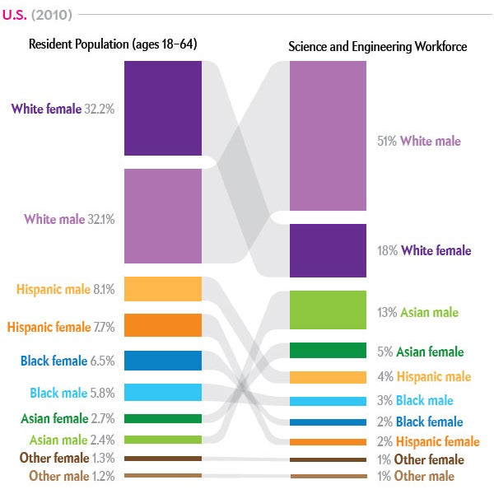
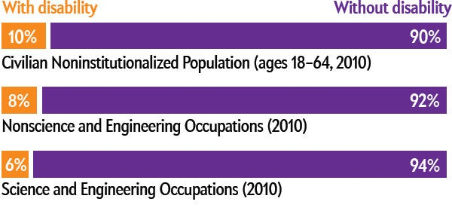
Marginalized people are often in the minority
https://www.scientificamerican.com/article/diversity-in-science-where-are-the-data/
Notes:
KL
If we decided that only women could fight sexism or only POC could fight racism, it would be very slow going.
Women, Minorities, and Persons with Disabilities in Science and Engineering: 2013, by National Center for Science and Engineering Statistics. National Science Foundation, 2013 (U.S. demographics, workforce and disability status);

Slide 22
Marginalized people have less power and influence
Of Fortune 500 CEOs:
< 7% are women
< 2% are Black
< 1% are openly gay
“The probability that a woman occupies a top management team position is 51 percent lower if another woman holds a position on the same team.”
http://onlinelibrary.wiley.com/doi/10.1002/smj.2461/full
Notes:
KL
Marginalized people have less power and influence. A recent analysis of the management teams of S & P 1500 corporations found that (read slide). It seems likely this applies to other categories like race and sexuality. So if you ever see members of the same marginalized group competing with each other for promotion, it’s probably because there really can only be one - and that’s a problem created by the mostly straight white cis men making those hiring decisions.

Slide 23
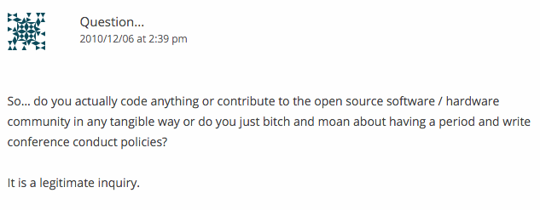
Marginalized people are seen as whiny & selfish
A response to the publication of a conference code of conduct example:
Notes:
KL
And finally, marginalized people fighting for increased diversity and inclusion are often seen as whiny, complaining, and jealous. (Read slide) And my favorite part: [click] “IT IS A LEGITIMATE INQUIRY”
http://geekfeminism.org/2010/11/29/get-your-conference-anti-harassment-policy-here/#comment-12020

Slide 24
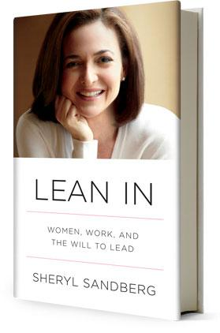
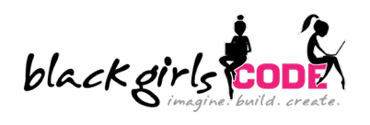
And yet...
and many more….
Notes:
EB
And yet with all these reasons why we shouldn’t be focusing on changing the behavior of the marginalized people, the diversity and inclusion in technology field is dominated by organizations focusing on helping marginalized people work harder and faster. Here is just a small sample of the groups that exist. (Read names, explain CODE2040 and CallbackWomen) And of course we have the mammoth that dominates them all: Lean In, the detailed handbook of how women simply need to work twice as hard as men - oh and hetersexual women, be sure to marry a man who will do his share of the housework and childcare - nevermind the short supply of such men. Now, I’m a fan of all of these programs, except for Lean In. The problem is on the next slide.
And here I want to give a plug for the one book of advice aimed at marginalized people that I can recommend: What Works for Women at Work. The nice thing about this book is that over half the women they surveyed were women of color, when most books like this focus on white women.

Slide 25
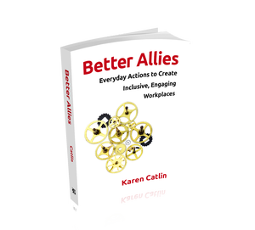
Resources for developing ally skills
@betterallies
@frameshiftllc
Dear Ally Skills Teacher
https://dearally.com
Ally Skills Workshop & UF Ally Skills Network (ASN)
Notes:
EB
This is a comprehensive list of books, non-profits, and organizations aimed at changing the behavior of allies in technology. The comparison between the two [flip back and forth between the slides] is stark. Clearly, there’s a lot of room for growth here.

Slide 26
Proposal:
2019 is the year to focus on ally skills
Notes:
EB
So here’s my proposal: That we make 2019 the year of focusing on getting allies to change their behavior, not marginalized people. And just to hammer home the point, here’s a reminder of all the reasons why we should focus on ally skills.
https://flic.kr/p/CaWDeZ

Slide 27
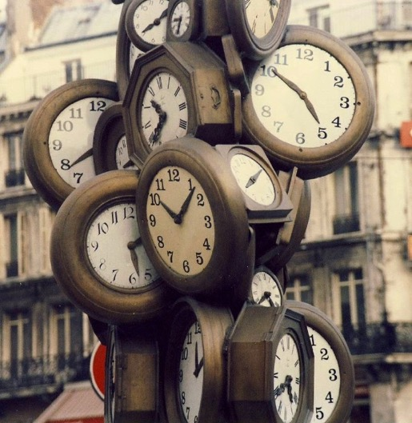
Allies have more time, energy, and money
CC BY Nick https://flic.kr/p/5bt6cp
Notes:
EB

Slide 28
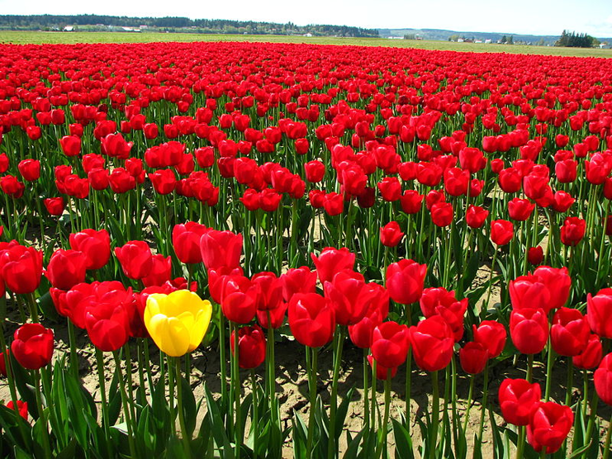
Allies are often in the majority
CC BY Alk3r https://alk3r.wordpress.com
Notes:
EB

Slide 29
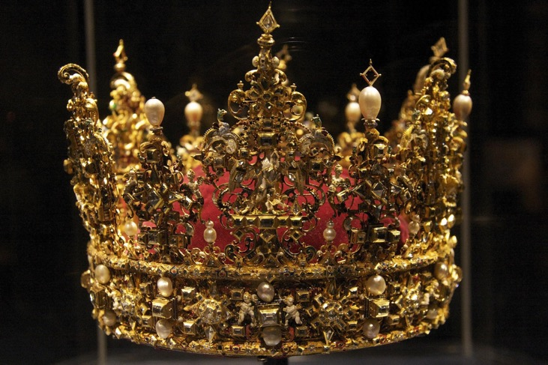
Allies benefit from more power and influence and, therefore, are less likely to be harmed
CC BY Chris Brown https://flic.kr/p/6kMMhW
Notes:
EB

Slide 30
What do good ally skills look like?
www.dental.ufl.edu
Notes:
EB
If being an ally is about actions, what do good ally skills look like?

Slide 31
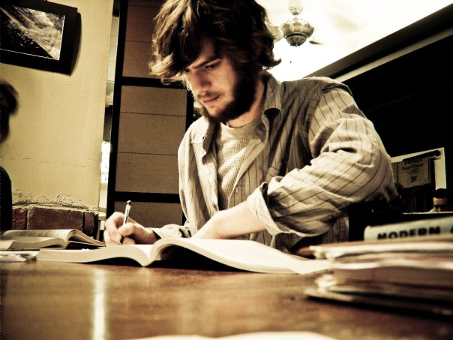
An ally self-educates
CC BY mer chau https://flic.kr/p/e2n2zi
Notes:
KL
An ally self-educates. time, effort, money to learn about oppression, without demanding marginalized people spoon-feed them the information, or do the research for them.

Slide 32
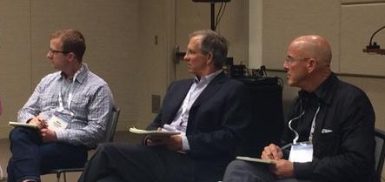
An ally listens
CC BY-SA Omoju Miller
Notes:
EB
An ally listens. A great example of this is what happened at the 2014 Grace Hopper Celebration conference. Despite widespread protest, the organizers scheduled a plenary panel called the Male Allies panel, where 4 men, all executives from big corporations like Google and Facebook, talked on stage while several thousand women listened in the audience. Predictably, it was a disaster, with every panelist sticking his foot in his mouth several times during the session. One of the panelists, Alan Eustace, now retired from Google, scheduled a new panel where the men sat and listened while the women took turns at the mic telling them about their experiences. It was eye-opening and an amazing save by Alan.
https://twitter.com/omojumiller/status/520322326924365825
https://twitter.com/alan_eustace/status/520273699857915905

Slide 33
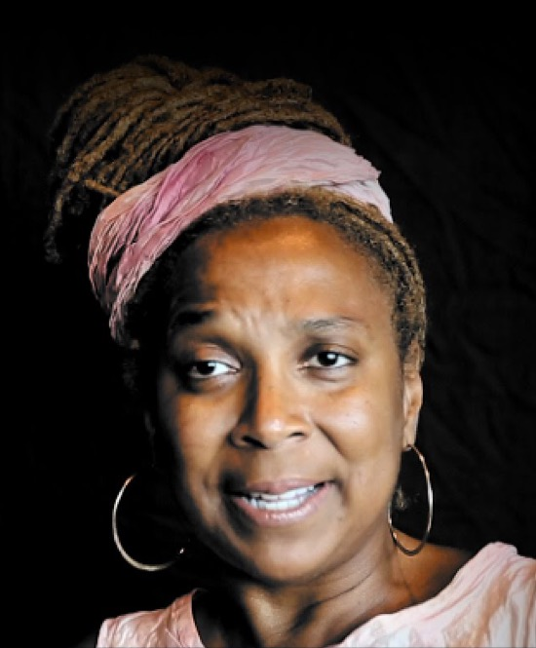
An ally gives credit
Women get less credit for co-authoring
Example: Whenever possible, credit legal scholar Kimberlé Crenshaw by name when using the term "intersectionality" (the concept that people can be subject to multiple, overlapping forms of oppression, which interact and intersect with each other)
http://scholar.harvard.edu/sarsons/publications/note-gender-differences-recognition-group-work
Notes:
KL
In economics, co-authors of papers are listed alphabetically. A study found that women in economics who co-authored papers were less likely to get tenure than men who co-authored at the same rate.
A great example of this is the cultural norm within social justice circles of, whenever feasible, crediting legal scholar Crenshaw
https://i.ytimg.com/vi/Nw78Urme_gk/maxresdefault.jpg

Slide 34
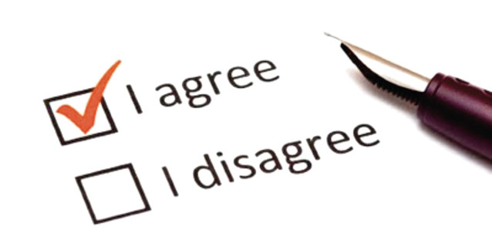
An ally asks for consent when possible
Notes:
EB
An ally asks for consent before doing something that could harm a marginalized person.
This is one of the hardest situations for anyone involved in social justice. Often, the path towards progress comes at the expense of an individual person who is a marginalized person. Think test court cases, such as when gay couples went to court to challenge laws against same-sex marriage. Each of those couples suffered hugely over a period of years, and some of them lost their cases. In the long term, it paid off for all gay couples. But the key here is that each of these couples voluntarily chose to be part of a test case. The version you’re likely to encounter is when a co-worker is suffering some kind of harassment, and if you make an issue of it in any way, that person is likely to suffer retaliation and could even lose their job - and this could all be perfectly legal. That’s the kind of situation where you need to ask for consent before you act, and if you don’t get it, you’ll have to find some other way to be an ally without putting them in danger. It’s really tough.

Slide 35
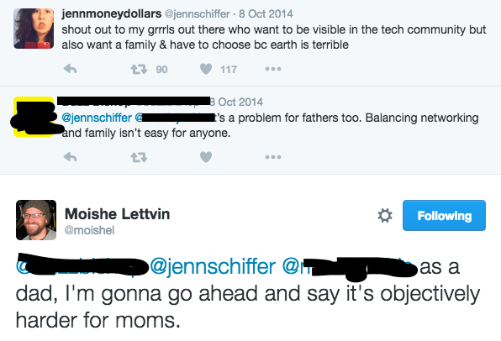
An ally keeps the focus on marginalized people
Notes:
KL
An ally keeps the focus on the marginalized people, redirecting when people try to re-center it on people of privilege. We’re so used centering privileged people in a discussion - for example, talking about racist police violence in terms of how it makes white people feel - that it takes effort to notice it happening and redirect the conversation back to the marginalized people.
https://twitter.com/moishel/status/519833743859912704

Slide 36
An ally speaks up & draws fire
Notes:
EB
The time for an ally to speak up and take center stage is when doing so will get them negative attention - if they are drawing fire away from marginalized people. Here's an example of a cis white woman who goes by hashoctothorpe on Twitter speaking up against racist and transphobic comments by speakers at a conference. I've blanked out the names and expletives. (Read slide) I'm happy to say that the conference organizers enforced their CoC and kicked out the speakers for the remainder of the conference, and both speakers apologized via Twitter.
https://twitter.com/hashoctothorpe/status/542898391575846912
https://twitter.com/hashoctothorpe/status/542897993175662592

Slide 37
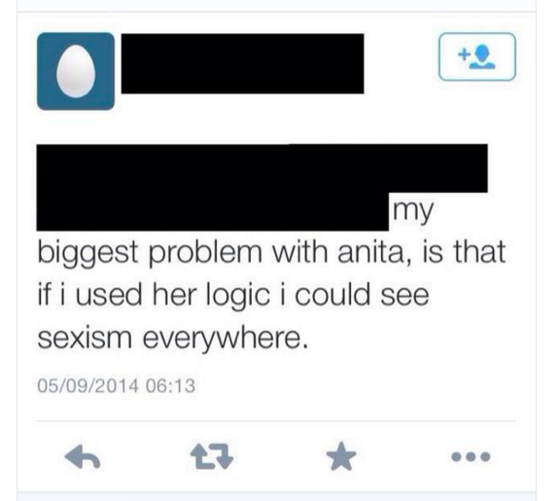
An ally uses their energy wisely
Notes:
KL
An ally uses their energy wisely. Being an ally doesn’t mean indiscriminately protesting every time you see oppression - you wouldn’t be able to go to the grocery store. It's like this anonymous Gamergater says (read slide). It does mean being strategic about how you use your time and energy so that you get the most effect out of it.

Slide 38
Charles’ Rules of Argument
Don't go looking for an argument
State your position once, speaking to the audience
Wait for absurd replies
Reply one more time to correct any misunderstandings of your first statement
Do not reply again
Spend time doing something fun instead
http://geekfeminism.wikia.com/wiki/Charles%27_Rules_of_Argument
Notes:
KL
One method is called Charles’ Rules of Argument, aka how not to get sucked into a flame war, which explains how to protest something on a mailing list or social media without wasting days of your time angrily reading and replying for no real benefit.

Slide 39
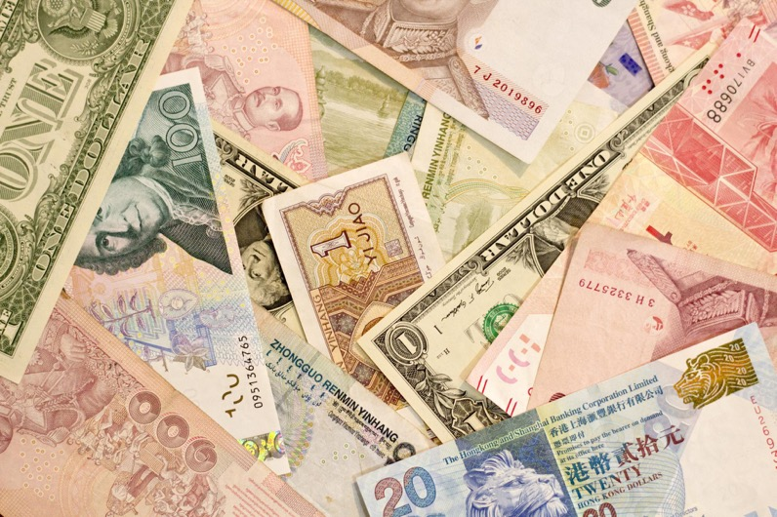
An ally spends money
CC BY-SA Japanexperterna.se https://flic.kr/p/srsFmV
Notes:
EB
An ally spends money. People with more privilege tend to have more money than people with less, and they tend to have more money than time. Donating money to non-profits that fight oppression, paying money to people from marginalized groups to teach and train you, investing in professional development for employees, funding scholarships - these are all great ways to use your money. Just donate the money you would make from practicing that specialized skill for the same amount of time.
* Write money for training into your broader impacts statement *
Speaking as a former non-profit executive director, please never ever offer to donate your time - the logistics to make use of that time are way too difficult and all you’re doing is forcing them to spend time politely rejecting you

Slide 40
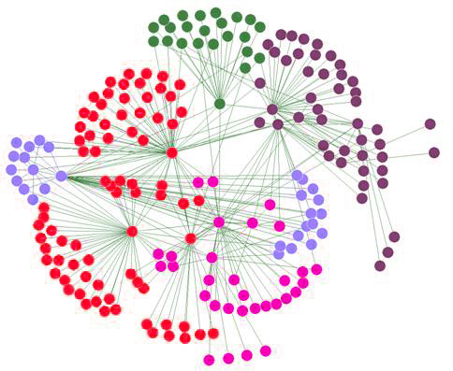
An ally uses their social capital
CC-BY-SA Daniel Tenerife https://commons.wikimedia.org/wiki/File:Social_Red.jpg
Notes:
KL
Another resource allies have is their social networks. People with more privilege are often well-connected to other people with even more privilege and power. Encourage people on your social networks to donate to those same non-profits. Amplify the voices of activists you follow. Connect people from marginalized groups with mentors or opportunities that will help them grow or raise their visibility. Escalate problems to the attention of people who can address them. Tell people why an issue matters to you and bring your influence to bear on setting goals and priorities.
https://commons.wikimedia.org/wiki/File:Social_Red.jpg

Slide 41
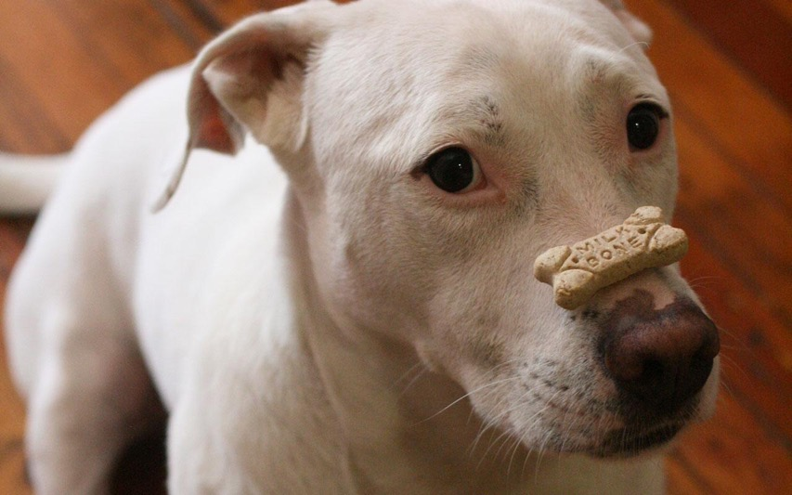
An ally acts even when it’s uncomfortable
CC BY Philip Bump https://flic.kr/p/9Ac4EN
Notes:
EB
An ally acts even when it’s uncomfortable.
It’s hard to be the person who calls out people using the words “lame” and “crazy” at work, but it’s even harder for the co-worker in a wheelchair or with an undisclosed mental illness to listen to it. The discomfort that you’re feeling as a bystander is a tiny proportion of what the marginalized person is feeling.

Slide 42
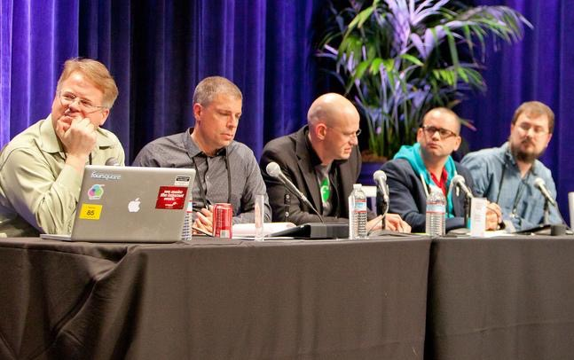
An ally sacrifices personal gain
CC BY kris krüg https://flic.kr/p/9m3nhH
Notes:
KL
direct people towards "inclusion riders", e.g. https://github.com/ErieMeyer/tech-inclusion-rider
The thing about privilege is that if you just relax into it and go with the flow, you’ll get all kinds of personal benefits. That’s how the system perpetuates itself. And sometimes you’ll need to give up unearned privilege if you want to be a good ally. A good example is if a white person is invited to be part of a panel at a conference, and it turns out that the whole panel is white. If they are already relatively well-known and powerful in their field, this is an excellent time to say that they are withdrawing from the panel unless at least one person of color is added. They may even give up their place in favor of a person of color. Remember, it's highly likely that someone more qualified than you wasn't invited to the panel because they weren't part of the social networks of the dominant race or gender.

Slide 43
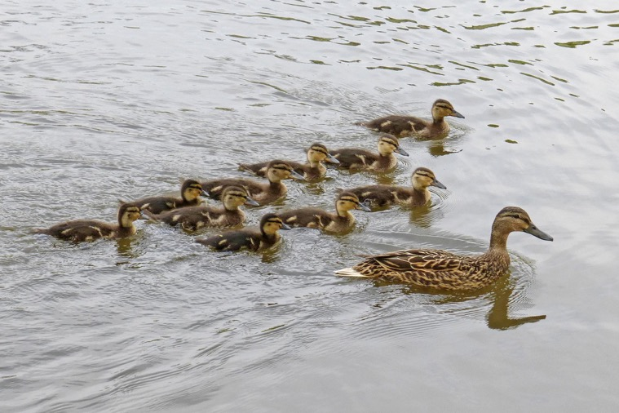
An ally follows leaders from marginalized groups
CC BY Tim Green https://flic.kr/p/ne1gEt
Notes:
EB
An ally follows leaders from marginalized groups.
Because people with privilege are used to being leaders and in control, and are encouraged to think they know more about everything, often privileged folks will start their own program to help marginalized people, without consulting with them or finding out what already exists. The thing is, most marginalized people know way more about the problems they are facing and usually have already started their own programs to make things better. They just need the support and money and influence of privileged folks, which they can’t get if people with privilege are off doing their own feel-good thing.

Slide 44
"Nothing about us without us"
Notes:
EB There's a slogan that has gained large adoption in disability and some other activism communities: "Nothing about us without us"
https://en.wikipedia.org/wiki/Nothing_About_Us_Without_Us

Slide 45
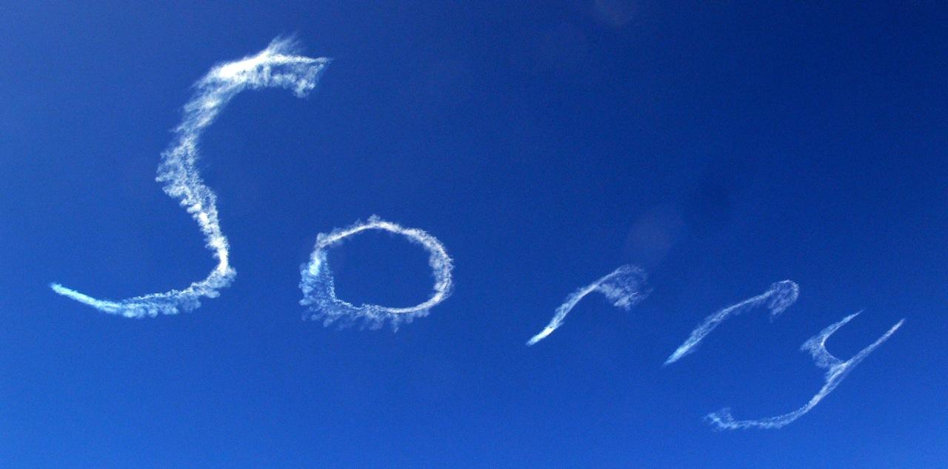
An ally makes mistakes--and apologizes
CC BY butupa https://flic.kr/p/95iJuo
Notes:
KL
An ally makes mistakes - and apologizes. We often see people who, when called out for saying something harmful, start listing off the social justice non-profits they’ve donated to, the diversity initiatives they’ve started, and the people they are related to who are members of marginalized groups. That’s (a) really embarrassing for the person doing it, (b) doing zero good for marginalized people.
An ally will apologize first, do some research, and then come back later if they figure out they were actually in the right.

Slide 46
In conclusion:
Most diversity and inclusion efforts focus on marginalized people
BUT ... marginalized people have less time, energy, power, and influence
however ... allies have more ability to make change
and … Ally skills can be learned
Let’s focus on ally skills
Notes:
EB

Slide 47
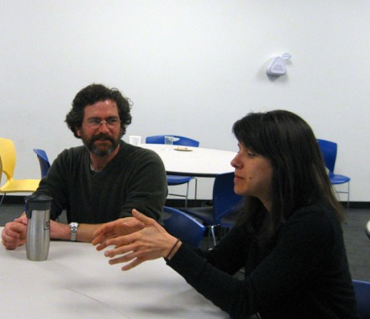
How to learn ally skills?
Take the Ally Skills Workshop
Come to Ally Skills Network meetings, held monthly
Follow @frameshiftllc
Subscribe to Dear Ally Skills Teacher https://dearally.com
CC BY-SA Ada Initiative
Notes:
KL
So, how do you learn Ally Skills?https://adainitiativedotorg.files.wordpress.com/2013/01/woman_explaining_lowdpi.jpg

Slide 48
Ally Skills 101: Why Allies?
Diversity and inclusion for academia and science in 2019
We acknowledge the land we are meeting on is the territory of many nations, including the Seminole and Timicua peoples.
http://frameshiftconsulting.com/
CC BY-SA Frame Shift Consulting, Sara Smollett,
Ellen Bledsoe, Kelsey Lewis
Notes:
EB
Territory acknowledgment: https://native-land.ca/territory-acknowledgement/
Territory acknowledgement is a way that people insert an awareness of Indigenous presence and land rights in everyday life. This is often done at the beginning of ceremonies, lectures, or any public event. It can be a subtle way to recognize the history of colonialism and a need for change in settler colonial societies.
However, these acknowledgements can easily be a token gesture rather than a meaningful practice. All settlers, including recent arrivants, have a responsibility to consider what it means to acknowledge the history and legacy of colonialism. What are some of the privileges settlers enjoy today because of colonialism? How can individuals develop relationships with peoples whose territory they are living on in the contemporary Canadian geopolitical landscape? What are you, or your organization, doing beyond acknowledging the territory where you live, work, or hold your events? What might you be doing that perpetuates settler colonial futurity rather than considering alternative ways forward for Canada? Do you have an understanding of the on-going violence and the trauma that is part of the structure of colonialism?

Slide 49
Who are we?
Ellen Bledsoe
Ph.D. Candidate
School of Natural Resources & Env.
she/her/hers
Kelsey Lewis
Ph.D. Candidate
Biology
she/her/hers
Notes:
KL

Slide 50
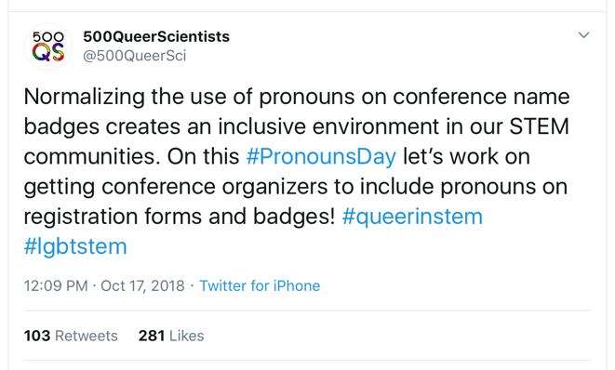
Pronouns and Go-Rounds
We often share names in classrooms and in meetings.
When we talk in groups, we refer to people by names and by pronouns:
“I’d like to hear from Rowan. I think she is familiar with this literature.”
It is critical that we refer to each other by the correct name and pronoun(s).
When someone’s name and/or pronouns are mistaken, they may feel uncomfortable and be less likely to participate.
Notes:
KL
At gatherings of many kinds, people do go-rounds to share their names with one another. Knowing what people like to be called is a key part of talking and relating with them. When we talk in groups, we not only refer to people by names, but also by pronouns. For example, a participant might say “I’d like to hear from Fatima. I think she has the information we are looking for.” Or “I agree with Sam and I think we should talk in more detail about his proposal.”
We want to make sure that people refer to each other by the name and pronoun that the person goes by. Frequently people assume they know what pronoun a person goes by based on looking at them. When we guess at people’s pronouns we might get them wrong. When people’s pronouns are mistaken they may feel uncomfortable and be less likely to participate in the group. We want everyone to participate here, and we want everyone to know how to refer to each other respectfully. So when we go around, each person is invited to share their name and information about what pronoun they go by. Some people may use “he/him/his,” “she/her/hers,” some may prefer to be referred to just by their names and not have a pronoun used, some people use “they/them/theirs” as a gender neutral-pronoun, and some people use gender neutral pronouns that may be new to some people in this room, such as “ze/hir/hirs” or others, and some people are open to being called by more than one set of pronouns. Please listen closely to each other and remember that if you forget what someone said later, you can ask them to remind you before you refer to them. It’s better to ask than to refer to someone by something they don’t like to go by. This exercise is important to helping everyone in this room participate and avoiding unintentionally disrespecting each other, so please take it seriously and listen carefully.
http://www.deanspade.net/2018/12/01/we-still-need-pronoun-go-rounds/
https://dev.to/sublimemarch/an-organizers-guide-to-pronoun-buttons-afb
https://lgbt.umd.edu/good-practices-names-and-pronouns
https://massivesci.com/articles/trans-visibility-science-queer-lgtbqia-transgender-inclusion/

Slide 51
Pronouns and Go-Rounds
Gender is not a binary!
Don’t assume someone’s gender
Let people tell you about their pronouns and about their gender—if and when they want to
Resources:
genderspectrum.org
”We Still Need Pronoun Go-Rounds” by Dean Spade http://www.deanspade.net/2018/12/01/we-still-need-pronoun-go-rounds/

Slide 52
Pronouns and Go-Rounds: How-to?
Goal: Create a space where no one’s pronouns are assumed
Examples of pronouns include :
she/her/hers, they/them, she/they, he/him, he/they, etc.
Pronoun sharing shouldn’t be required
Refer to pronouns as pronouns, not preferred pronouns or preferred gender pronouns (PGPs)
You can:
Ask your class to agree as a community that we will either use they/them pronouns or won’t refer to someone with pronouns, if we don’t know what their pronouns are.
Notes:
KL

Slide 53
What can I do?
Add money into a grant budget for ally training
Include territory and treaty acknowledgments in your talks and publications
Consider adding your pronouns to:
E-mail signature
Conference badges
Title slides
Business cards
Your class syllabus
Advocate for pronoun go-rounds in meetings and in classrooms
Create a space for your students to provide their name and pronouns
Blank cards for students to provide name (in addition to legal name) and pronouns
Wear pronoun buttons when they are provided
Notes:
KL

Slide 54
Come to the Ally Skills Workshop!
There is an Ally Skills Workshop for undergrad/grad students and postdocs:
October 14, 1-4 PM
UF Informatics Institute
Registration link: https://forms.gle/eSPc1V27qE4CiJqq5
Notes:
EB

Slide 55
Q&A
Ellen Bledsoe ellen.bledsoe@ufl.edu @bleds22e
Kelsey Lewis lewis23a@ufl.edu @feministbiology
https://ufallyskillsnetwork.weebly.com
Frame Shift Consulting: http://frameshiftconsulting.com/ally-skills-workshop/
Notes:
EB

